Slide 1
Door Frame Inspection System
For
ASSA ABLOY
Wiring Layout
By
Girish.B
Date : 2022/08/29

Slide 2
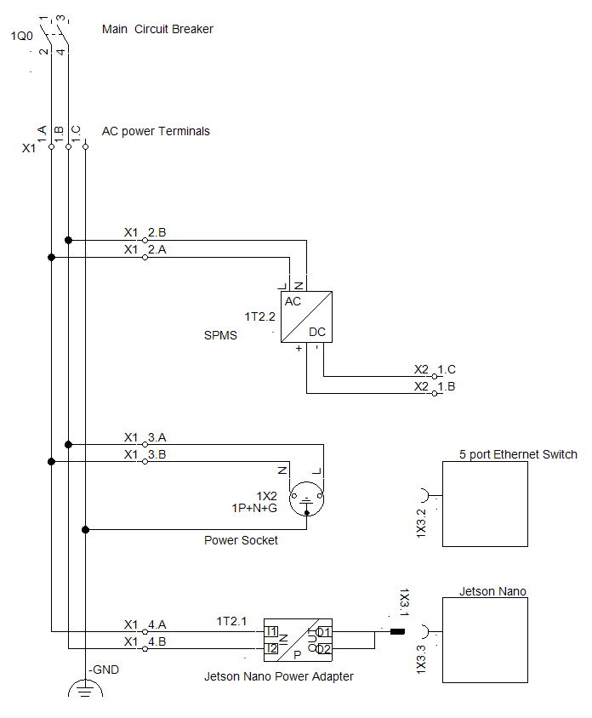
AC Power Wiring
Red Wire (1.5Sq.mm)
Black Wire (1.5Sq.mm)

Slide 3
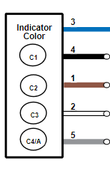
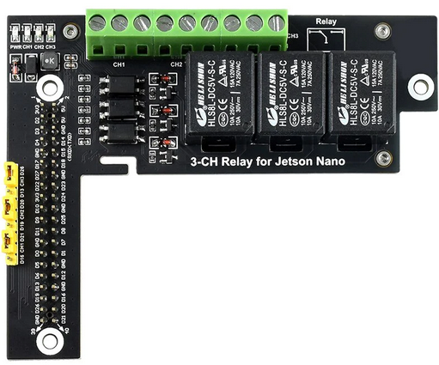
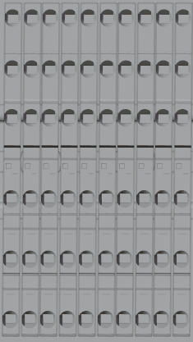
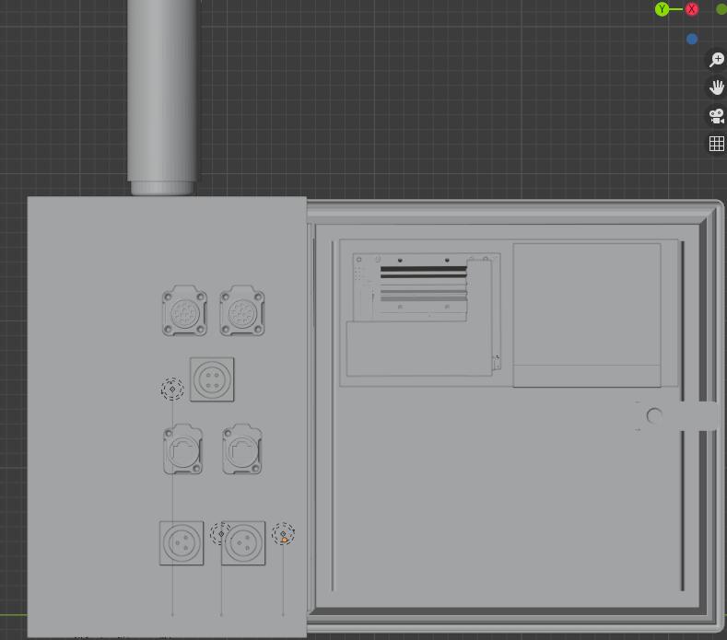

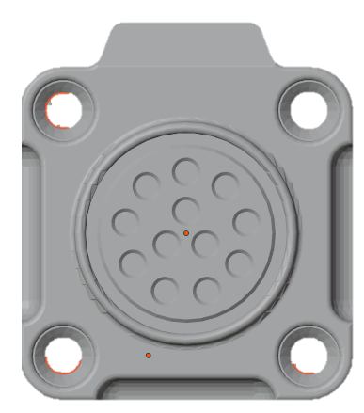

Control Wiring – inside Panel
Stack Light
Jetson Nano
Carrier Board
BL
24
14
3V (Pin#1)
BK
12
GND ( Pin#6)
BN
21
11
D4 (Pin#7)
WH
Relay
Elmex
A1
A2
Jetson Nano Relay
0VDC
0VDC
24VDC
24VDC
BN
L1-CN (3 Pin)
L2-CN (3 Pin)
X2 – Control Terminals
X3 – Light
Terminals
Pin Connections
1 : BN (24V)
2 : BK( Light ON)
3 : BL (0V)
Pin Connections
1 : BN (24V)
2 : BK( Light ON)
3 : BL (0V)
BK
BK
BL
BN
GN
GN
BL
Camera 12 Pin Hirose Cable -Connections
White
Green
Blue
Red
Gray
Black
Violet
Brown
Yellow
Pink
Gray/Pink
Red/Blue
WH
Same Wiring for both connector
(Black wire to be shorted)
WH
S1-CN ( 4 Pin)
C1-CN (12 Pin)
C2-CN (12 Pin)
Pin Connections
1 : BN (24V)
2 : BK ( Sensor Output)
3 : BL ( 0V)
Pin Connections
1 : WH (0V)
2 : GN ( 24V)
Pin Connections
1 : WH (0V)
2 : GN ( 24V)
TB3 – Light Power Terminals

Slide 4
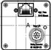


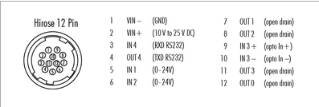
Camera Field Wiring Details
E1-CN
(RJ45 – Female Panel Side)
Ethernet Cable
Male to Male
C1-CN (12 Pin)
Female- Panel Side
C1-CN (12 Pin)
Male- Camera End
Cam1
exo183CGE
Hirose Cable
Camera Power & IO cable
Pin Connections
1 : WH (0V)
2 : GN ( 24V)
Pin Connections
1 : WH (0V)
2 : GN ( 24V)
E2-CN
(RJ45 – Female Panel Side)
Ethernet Cable
Male to Male
C2-CN (12 Pin)
Female- Panel Side
C2-CN (12 Pin)
Male- Camera End
Cam2
exo183CGE
Hirose Cable
Camera Power & IO cable
Pin Connections
1 : WH (0V)
2 : GN ( 24V)
Pin Connections
1 : WH (0V)
2 : GN ( 24V)

Slide 5
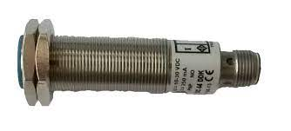

Sensor Field Wiring Details
S1-CN (4 Pin)
Female- Panel Side
S1-CN (4 Pin)
Male- Sensor End
Sensor Cable
Black , 4 Core
Sensor 1
Pin Connections
1 : BN (24V)
2 : NC
3 : BL ( 0V)
4 : BK ( Sensor Signal)
Pin Connections
1 : BN (24V)
2 : NC
3 : BL ( 0V)
4 : BK ( Sensor Signal)

Slide 6
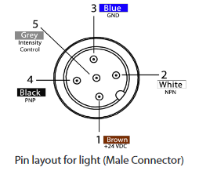

Light Field Wiring Details
L1-CN (3 Pin)
Female- Panel Side
L1-CN (3 Pin)
Male- Light End
5PM12-10
Standard 5 Core, 5 Pin Cable
Light 1
Free Lead End
Connector End
LC300
Pin Connections
1 : BN (24V)
2 : BK ( Light ON)
3 : BL ( 0V)
Pin Connections
1 : BN (24V)
2 : NPN ( Not Used)
3 : BL ( 0V)
4 : BK ( PNP / Light ON)
5 : GY ( Not Used)
Pin Connections
1 : BN (24V)
2 : BK ( Light ON)
3 : BL ( 0V)
L2-CN (3 Pin)
Female- Panel Side
L2-CN (3 Pin)
Male- Light End
5PM12-10
Standard 5 Core, 5 Pin Cable
Light 2
Free Lead End
Connector End
LC300
Pin Connections
1 : BN (24V)
2 : BK ( Light ON)
3 : BL ( 0V)
Pin Connections
1 : BN (24V)
2 : NPN ( Not Used)
3 : BL ( 0V)
4 : BK ( PNP / Light ON)
5 : GY ( Not Used)
Pin Connections
1 : BN (24V)
2 : BK ( Light ON)
3 : BL ( 0V)

Slide 7
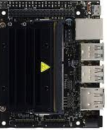
Network Layout
Jetson Nano
Ethernet Switch
Port 5 – Spare
E1-CN
(RJ45 )
Cam1
exo183CGE
Port 4 – Jetson Nano
E1-CN
(RJ45 )
Port 3 – Main Ethernet
Port 2 – Camera 2
E1-CN
(RJ45 )
Cam2
exo183CGE
Plant Ethernet
Port 1 – Camera 1

Slide 8
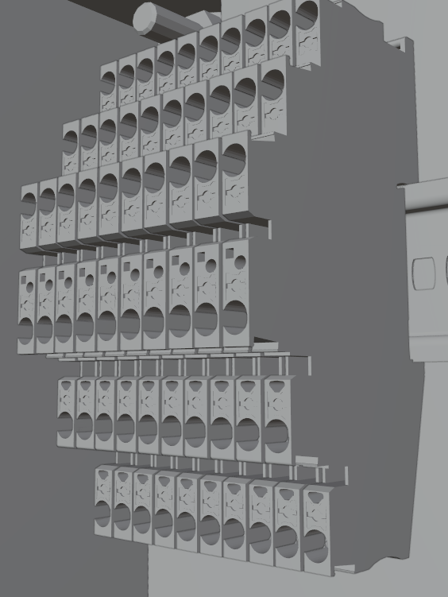
X1 Terminal Layout
X2 Terminal Layout
X3 Terminal Layout
AC Power
Signals
Spare
Neutral
24V
24V
GND
0V
0V

Slide 9
Panel Connector Layout
Stack Light
Stack Light
Front View
Side View
C1-CN
(12 Pin)
C2-CN
(12 Pin)
S1-CN
( 4 Pin)
E1-CN
(RJ45)
E2-CN
(RJ45)
L1-CN
(3Pin)
L2-CN
(3Pin)
E3-CN
(RJ45) Main Ethernet Connection
Main Power Entry

